Slide 1

Handwritten Digit Recognition
Ruchita Raut 19104033
Kushal Todi 19104047
Pratik Dhumal 19104031
Notes:
1

Slide 2
Contents
Introduction
Technology Stack
Implementation
Conclusion
Notes:
2

Slide 3
1. Introduction
Handwritten Digit Recognition is the ability of computers to recognize human handwritten digits.
It is not an easy task for the machines, because handwritten digits are not perfect and can be made with many different flavors.
Handwritten digit recognition is the solution to this problem which uses the image of a digit and recognize the digit present in the image.
Notes:
3

Slide 4
Problem Identified :
Time was spent on recognizing digits manually, which could be automated with great accuracy.
Solution Proposed:
A model can be developed to recognize the human handwritten digits effectively.
To predicts the actual handwritten digit considering the shape and the images of the same.
Notes:
4

Slide 5
2. Technology Stack
Technologies Used: -
1. Python
2. Tkinter
3. Numpy
4. Keras
Notes:
5

Slide 6
3. Implementation
Import the Dataset
Notes:
6

Slide 7
Pre-processing the data

Slide 8
Creating the Model

Slide 9
Training the Model

Slide 10
Evaluating the Model

Slide 11
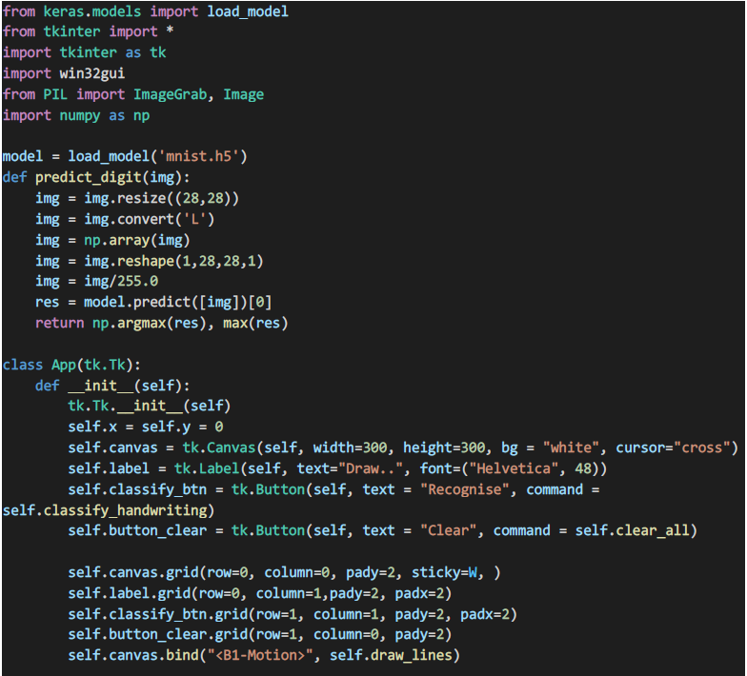
Creating the GUI

Slide 12
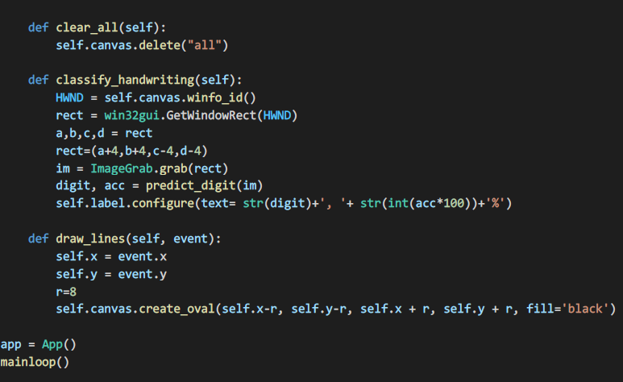

Slide 13
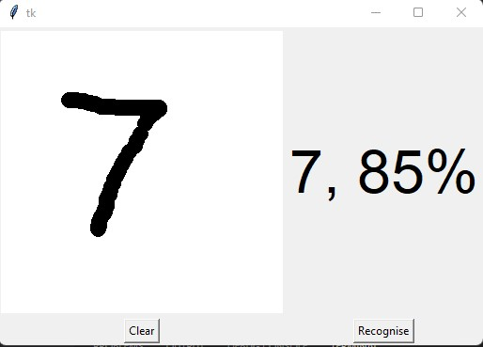
Result

Slide 14
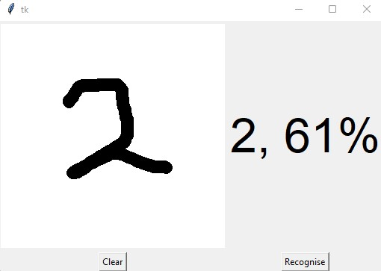

Slide 15
Algorithm Used
Convolutional Neural Network (CNN)
A Convolutional Neural Network is a Deep Learning algorithm that can take in an input image, assign importance to various aspects/objects in the image and be able to differentiate one from the other.
Convolutional neural networks are more complex than standard multi-layer perceptrons, so we will start by using a simple structure, to begin with, that uses all of the elements for state-of-the-art results. Below summarizes the network architecture.

Slide 16
Conclusion
Convolutional Neural Network is very effective for image classification purposes.
For GUI we used Tkinter, wherein we drew a digit on canvas, then classified the digit with it’s accuracy.
Hence, we have created a Model in Python to detect human handwritten digits.

Slide 17
Thank You...!!
Notes:
17

